Slide 1
Introduction to MATLAB
기초전자기학 및 연습(003)
김성재 교수님
2016/09/21
ENERGY, ENVIRONMENT AND SUSTAINABILITY LABORATORY

Slide 2
MATLAB Download
http://my.snu.ac.kr Login
>>Quick Menu
>>SW Download (소프트웨어다운로드)
>>Down (Upper right corner)
>>#13, “[MathWorks] MATLAB / Simulink”
>>Setup file (MathWorks R2014A) Download

Slide 3
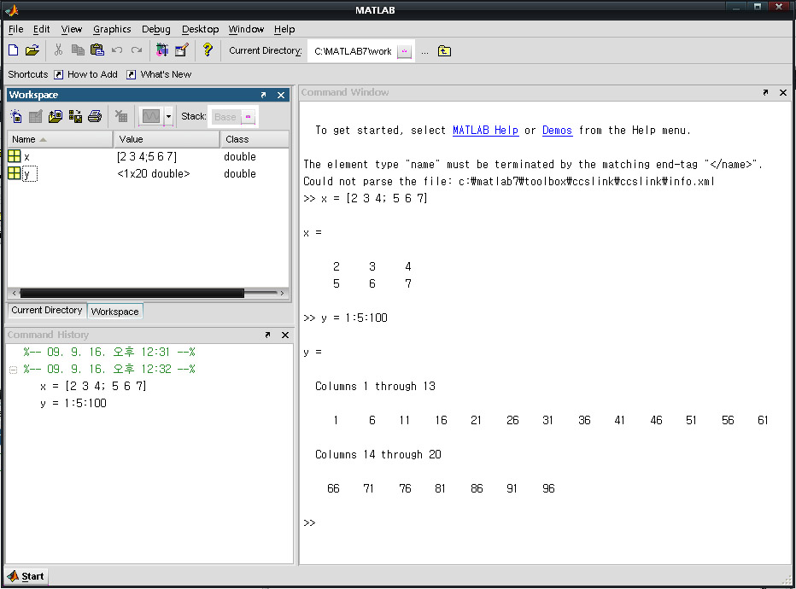
MATLAB Graphical interface
1. Command Window
-MATLAB Window for entering commands
ex) y= 1: 5 : 100
2. Command History
-Record the commands
3. Workspace
-show information about defined variables
③ Workspace (작업 공간)
① Command Window (명령 창)
② Command History (명령 내역)
Notes:
레이아웃->명령-> 도킹됨으로 하면 안에 보임

Slide 4
Useful command 1
“[ ]” : form matrices. 행렬 생성에 사용.
“( )” : used with a matrix name to identify specific elements. 행렬에서 원소 선택에 사용.
“ ; ” : 1. suppresses output when used in commands.
2. separated rows in a matrix definition
“ , “ : separates matrix elements
“ % “ : Annotation process. 주석 처리.

Slide 5
Useful command 2
ctrl + c : Command for getting out from the infinite loop.
ctrl + r : Create annotation(주석 처리).
ctrl + t : Cancel annotation(주석 처리 취소).
ctrl + s : Save document!! (Use it frequently)

Slide 6
Useful command 3
clear all: clear all the variables and functions.
clc : clear command screen.
who : lists variables in memory
help : invokes help utility. Smarter than teaching assistant!!
E.g.) help plot, help cos
kr.mathworks.com : matlab official website.
You can get detail information of the functions
www.google.co.kr : knows everything.

